Slide 2
Drive Trains , Object Manipulators, and Lifting Mechanisms
Driving Competition
Gear Ratios and Motor Control
Competition Breakdown and Analysis
Team Planning
CONCEPTS

Slide 3
VEX IQ Crossover
2016-2017
VEX IQ CROSSOVER
There are 28 hexballs, 2 scoring zones, 16 low goals, 12 elevated goals, and 1 bridge on the field.
Scoring:
Hexball scored in scoring zone | 1 point
Hexball scored in low goal | 3 points
Hexball scored in the elevated goal | 5 points
1 robot parked on the bridge | 5 points
2 robots parked on the bridge | 15 points
2 robots parked and balanced bridge | 25 points

Slide 4
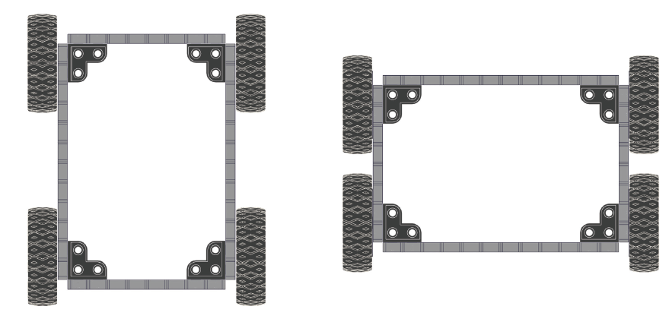
Drive Trains
The robotic subsystem that provides the robot the ability to move around the field is often known as a Drivetrain.

Slide 5
Construct the following drivetrains and drive them through a course similar to the one below.
Discuss as a group what worked well and what didn’t.
Drive Trains

Slide 6
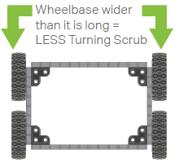
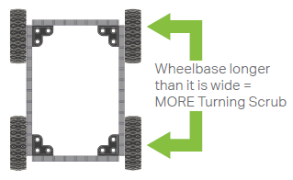
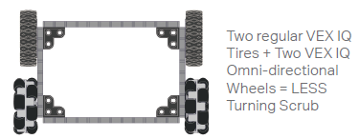
Turning Scrub is friction resulting from turning. Greater turning scrub = harder to turn
Drive Trains

Slide 7
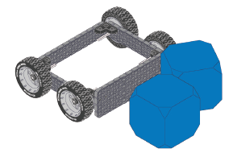
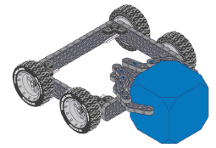
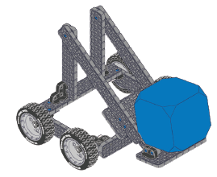
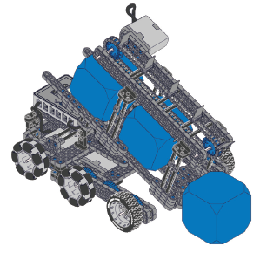
Object Manipulator
Object Manipulator – Allows a robot to interact with objects in its environment.
Friction Grabber
Plows
Scoops
Accumulator

Slide 8
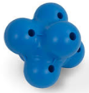
Object Manipulator
What are some physical characteristics of the object?
Do these characteristics present challenges in moving the object?
You will be trying to move the object the following ways:
From a flat surface to another flat surface.
From a flat surface to an elevated surface.
Discuss as a team:
What kind of motion could move each object horizontally and vertically?
As a team: construct and test an object manipulator for a hexball.

Slide 9
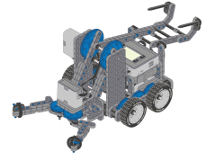
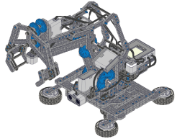
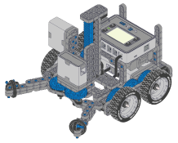
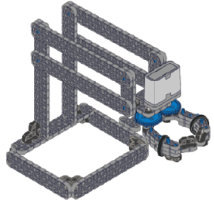
Lift Mechanisms – Allows a robot to pickup an item.
Lift Mechanism
Rotating Joint
Linkage
Elevator
Linkage – 4 bar

Slide 10
Lift Mechanism
Discuss as a team:
In the VEX IQ Crossover game, what lift movements are involved?
What kind of lift could move the object?
As a team: construct and test an lift for a hexball.

Slide 11
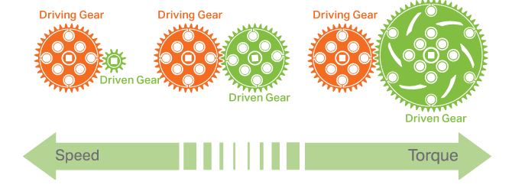
Gear Ratios
Speed vs. Torque
Driving gear – attached to the motor
Driven gear – attached to the mechanism
Speed – large gear to a smaller gear
Torque - small gear to a larger gear

Slide 12
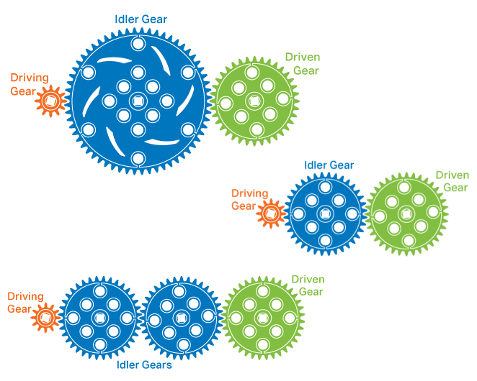
Gear Ratios
Idler Gears
Idler gears have no effect on the gear ratio, they just transmit the power.

Slide 13
Gear Ratios
Idler Gears
Idler gears have no effect on the gear ratio, they just transmit the power.

Slide 14
Center of Gravity
Center of Gravity
Balance of weight of the robot in all positions.

Slide 15
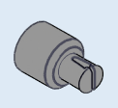
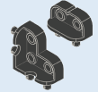
Building Tips
Balance of weight of the robot in all positions.
Building Tips
Will help hold the axle in place.
Strongest connectors for stability. Try to use these pieces instead of pins where possible.
Think through how everything will connect.
Keep the design clean.
Pay attention to the center of gravity.

Slide 16
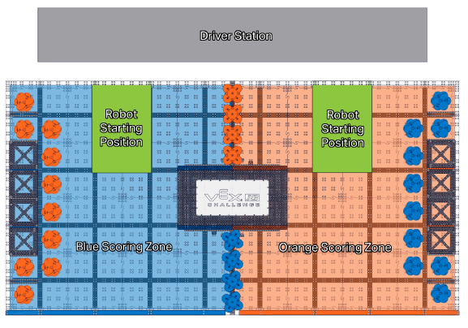
Game Analysis
Robot Starting Positions and Driver Station

Slide 17
Scoring
Game Analysis
There are 28 hexballs, 2 scoring zones, 16 low goals, 12 elevated goals, and 1 bridge on the field.
Scoring:
Hexball scored in scoring zone | 1 point
Hexball scored in low goal | 3 points
Hexball scored in the elevated goal | 5 points
1 robot parked on the bridge | 5 points
2 robots parked on the bridge | 15 points
2 robots parked and balanced bridge | 25 points

Slide 18
Game Analysis
How the Competition Works:
2 teams are randomly assigned to work together as an alliance.
Both teams at the end of the Teamwork Match are awarded the points.
The bridge details:
Balanced – the bridge is balanced when neither end is touching the floor or is supported by a hexball.
Teams may choose to start the bridge tipped to either side or balanced.
Parked – a robot is parked if it is on the bridge and not touching the floor.
Elevated goals, low goals, fence , scoring zones.

Slide 19
Game Analysis
How the Competition Works:
Scored hexball –
Not being touched by a robot
Partially within the three dimensional volume of the goal of the same color.
You cannot earn multiple points for hexballs in the same goal.
If a hexball is scored in multiple goals it will only count as scored in the highest goal.
Teamwork Match will consist of 60 seconds of driving. 2 students will drive the robot and will switch the controller between 35-25 seconds.

Slide 20
Game Analysis
General Rules:
At the beginning of the match each Robot must:
Only be contacting the floor
Fit within a 13”x20” area of the bounded starting position
Be no taller than 15”
During the match, Robots may not expand beyond the 13”x20” area, but may expand beyond the 15” height restriction.
Repairing a robot – set down the controller and get the referee’s attention.
Adults may assist in urgent situations, however adults should never work on a robot without the students actively present.

Slide 21
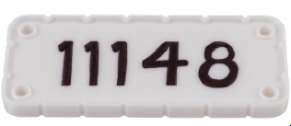
The Robot:
2 VEX IQ license plates on opposing sides.
Only VEX IQ components designed for robot construction can be used.
Robots may only contain the following:
1 robot brain/microcontroller
6 Smart Motors
Parts cannot be modified.
Game Analysis

Slide 22
Game Analysis
Game Analysis
As a team breakdown the game:
What is the object of the game?
What will score the most points?
How will you work with your ideal partner?
What will you do in these situations to score the most points possible?
What if your partner cannot score hexballs?
What if your partner cannot get on the ramp?
Programming skills and robot skills strategies?
What are you as a team want to focus on doing?
Share your homework robot designs.
Begin working as a team to build. Good Luck!

